Slide 1

Welcome to

Slide 2
Supreme Council
Membership Services Committee
Alan W. Adkins, Chairman
Billy W. Sloan
Karl J. Hinkle
Roger B. Nelson
Notes:
Mention the Membership Committee
Acknowledge Actives and Deputies present and any Grand Masters
Intro SGIG C obb for his remarks on behalf of the orient

Slide 3
Welcome to

Slide 4

Notes:
As Masons, we tend to get stuck in our ways.
How many times have we all heard the age-old Masonic phrase “that’s not how we used to do it”?
The problem is that if we do things how we’ve always done them, we will continue to get the result we’ve always gotten.

Slide 5

Notes:
But its time for us to start thinking outside the box.
For many years, the model of the Scottish Rite is to have Master Masons come to the Valley to become Scottish Rite Masons.
But what if we turn that idea around and Bring the VALLEY to the Master Masons?

Slide 6
Notes:
That is what the Rite on the Road Program is all about.
Rather than having Masons drive from all over your Orient to come to a Valley, with permission of your SGIG or Deputy and the Grand Lodge in your Jurisdiction the Valley can use minimal props and visit a Blue Lodge, open a lodge of perfection and confer the 4th degree.
For the Blue Lodge, this serves as an exciting Masonic engagement opportunity for the Masons of that Lodge and for the Valley it’s a chance to welcome new members.
Our Brothers in the NMJ have been using a version of this program on video for the last few years, with great success.
But can it be done in person? YES.
Any location that a blue lodge meets will work very well for our scottish rite degrees.

Slide 7
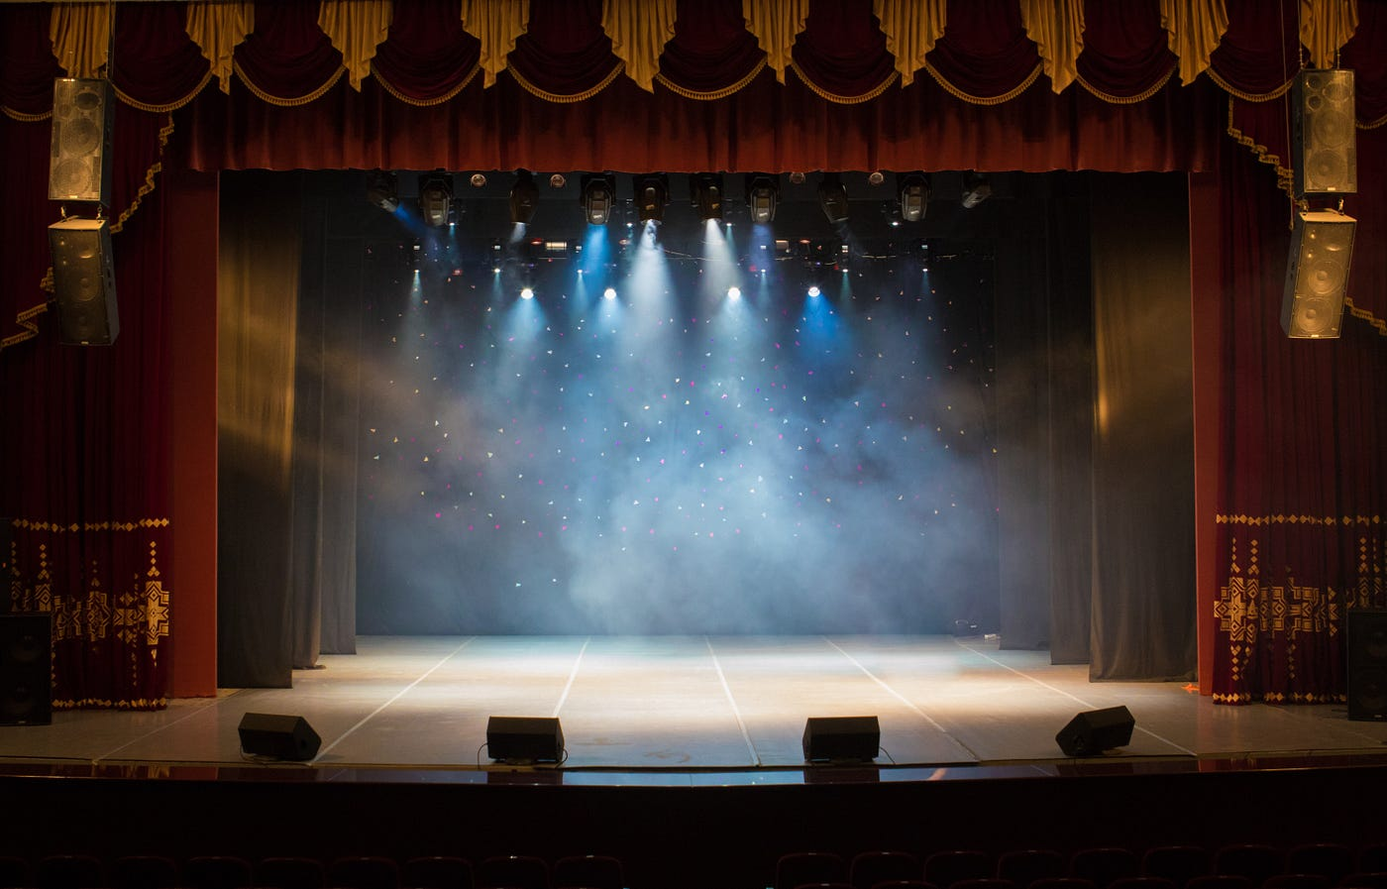
Notes:
Performing the degrees on stage or in a fully outfitted Lodge room setting, is great.
But our degrees are powerful and transformative even without stage lights or tons of props.
The degrees can be performed virtually anywhere, anytime and give More Light in Masonry to Master Masons. Which is our promise.

Slide 8

4°
Secret Master
Notes:
And to prove that we are going to have the Scottish Rite Valley of Dallas Degree team perform the fourth degree right now.
I would like to now introduce the degree Thomas Pope PR & Director of Work Valley of Fayetteville.

Slide 9
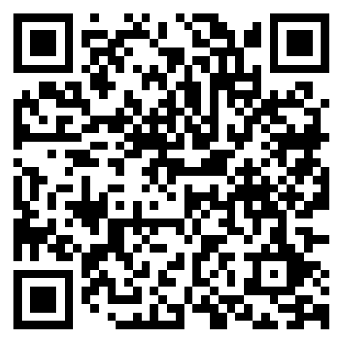
Traveling Rite
How-To Guide
Scan the QR Code to receive the
Traveling Rite Guide
Notes:
We have created a special how to guide for the Rite on the Road program, and we are calling it our Traveling Rite Guide.
To keep this part of the presentation a surprise for the other conferences, we are going to send you the guide the Monday immediately following the final conference on April 13.

Slide 10
Welcome to
Notes:
Break

Slide 11
Topics DO Matter
Choose Wisely!

Slide 12
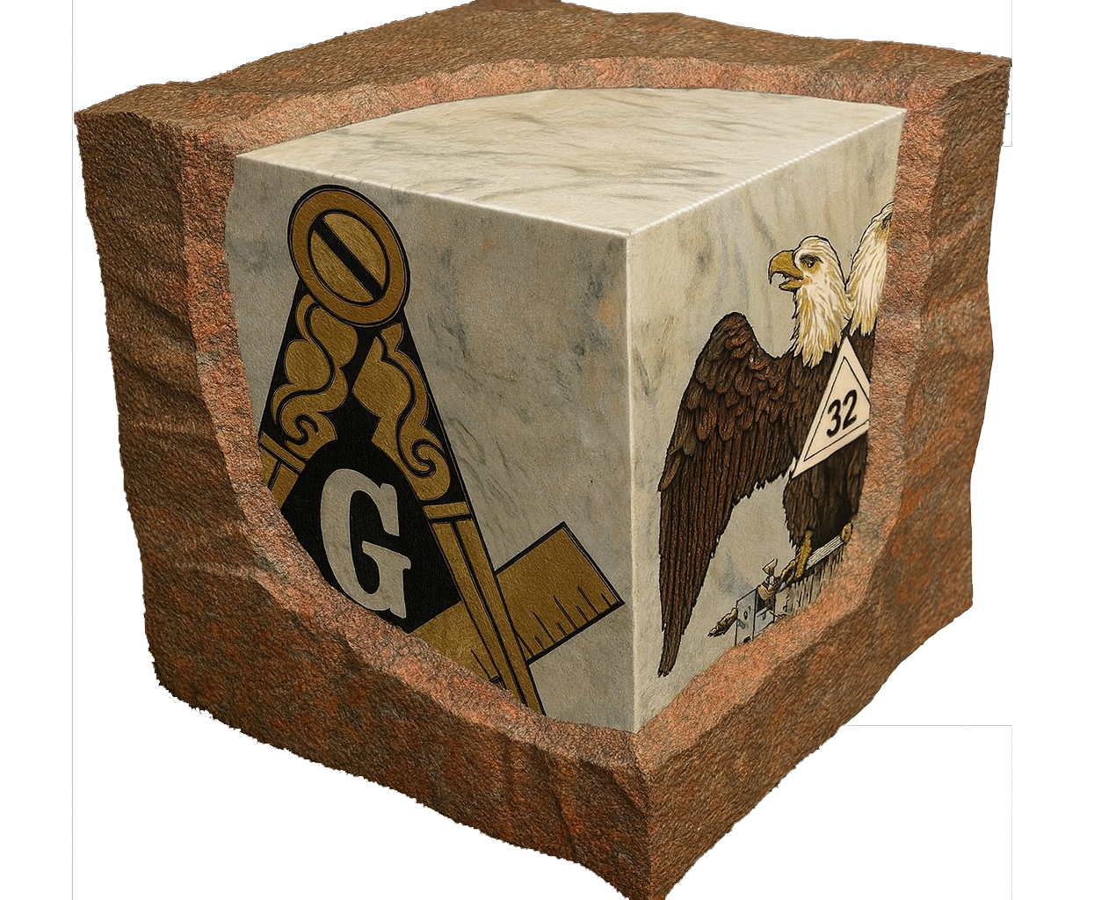
BELIEVE
Membership Matters
Bob Weatherford, 33°
Notes:
Have you truly reflected on what these words mean to you?
For years, I’ve included a reminder in my emails: “Remember… Your Membership Matters!”
Everyone needs someone who believes in them. I can tell you that I am here to talk to you, only because someone else believed in me and saw a potential that I didn’t recognize.
As I look around this room, I’m hoping that I am seeing the future of Scottish Rite leadership. It’s there even if you don’t realize it yet. You attend meetings, participate actively, and invest your time and resources in conferences like this. So, I believe in you, and clearly, you believe in yourselves.
For that belief to be meaningful, your membership must matter to you. The question is, how do you take what you learn here and inspire others back home in your Valley to feel the same commitment to their membership? That’s the critical question we all need to answer.
Each week, much of my time is dedicated to reaching out to members who have drifted away, particularly our senior members at risk of being forgotten, as well as assisting Valley secretaries and staff. My key takeaway from these conversations is that there is a recurring theme of poor or even a lack of positive communication and engagement. That leads to members being lost and that’s when membership truly matters.
Let’s look at the fight we are actually fighting.

Slide 13
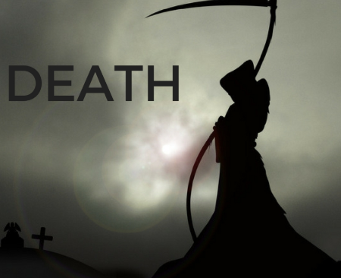

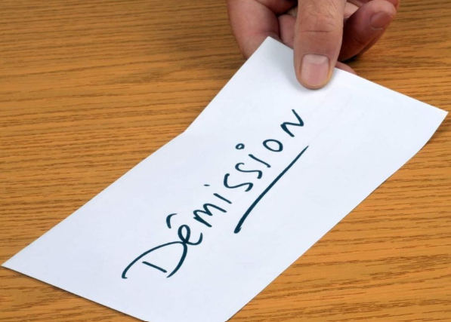
A Battle on Three Fronts
Death
Suspensions
Demits
Notes:
The Fight
1) Death takes away about 4% on average each year. You may be saying, there’s nothing we can do about that. You’re kind of right but if just 4% of membership plus 1 sponsored a man in each year, we’d cancel out the death toll and grow.
2) We generally lose .75% to 1.5% to suspensions. This is by far the easiest stat to overcome.. Engagement, retention and restoring just 2% would be a nice number, wouldn’t it?
3) Less than 1/10th of 1% of our losses are due to demits. Except in Valleys where there is a large military or maybe a college student presence, I have to tell you that a large number of demits is a clear indicator that something is wrong in your Valley.

Slide 14



ORIENT & VALLEY
MEMBERSHIP COMMITTEES
Engagement
Retention
Restoration
Notes:
In early fall, we initiated a request for the SGIGs and Deputies to select and appoint an Orient Membership Chairman. < TALK ABOUT THIS AND HOW THEY CAN CHOOSE HOW TO BEST COMPLETE THE WORK>
What is the work? – Rebuilding our Fraternity – talk about it
Figuring out a starting point. – YOU – The hope here is that you will take what you hear at these workshops back home to your Valleys and actually implement some of the great ideas you’ve heard.
Do’s and Don’ts – A plan and the execution of that plan.
Learn and adapt best practices - We can’t change other people. We can change ourselves and we can influence changing of the environment.
We have other presenters that are going to be focusing on Engagement. Retention goes hand in hand with Engagement, so I will focus a bit on Restoration.

Slide 15


Welcome Home
Notes:
Restoration and what it takes: Do’s and Don’ts.
Do plan <my thoughts on planning> TruthFinder and other sites.
Do research <my thoughts and recommendations on research>
Do reach out <my thoughts on best ways to reach out, hint… not the US Mail>
Do talk about the missing man and not the missing dues <what to say and what not to say>

Slide 16
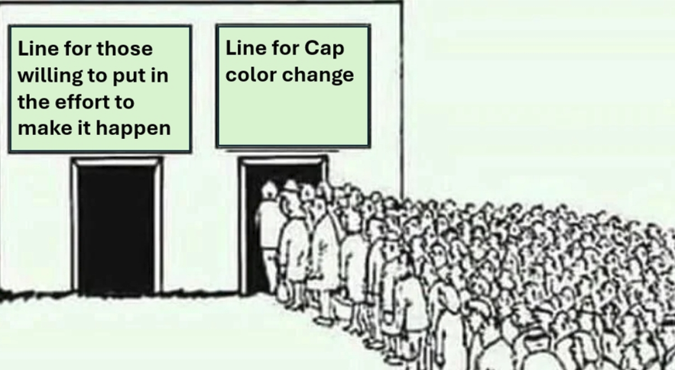
Notes:
Which line are you choosing? – You can’t help to make a good man better by giving him more of what he already doesn’t appreciate. So, give members something to appreciate.
You learn the most about others when they don’t get what they want from you. If you choose to go home and continue along the same path we are on now, nothing will change.

Slide 17
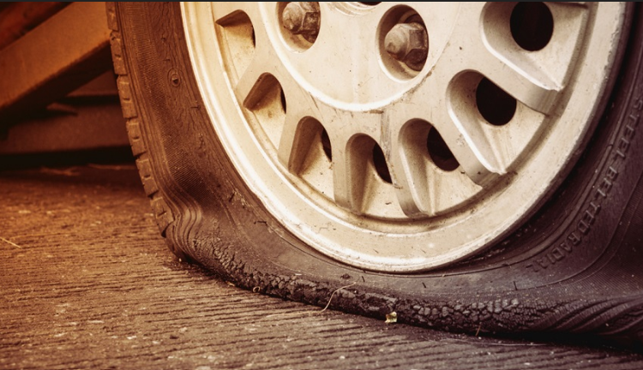
Closing & Questions
Notes:
Do we continue to focus on airing this up, or do we repair it and move forward.
This is all on us Brothers. Make no mistake, there is a major leak in our Masonic tire. Unless we ALL decide to fix the leak, there will be no holding up.
Questions?

Slide 18
Welcome to

Slide 19

Scottish Rite Research Society Updates

Slide 20
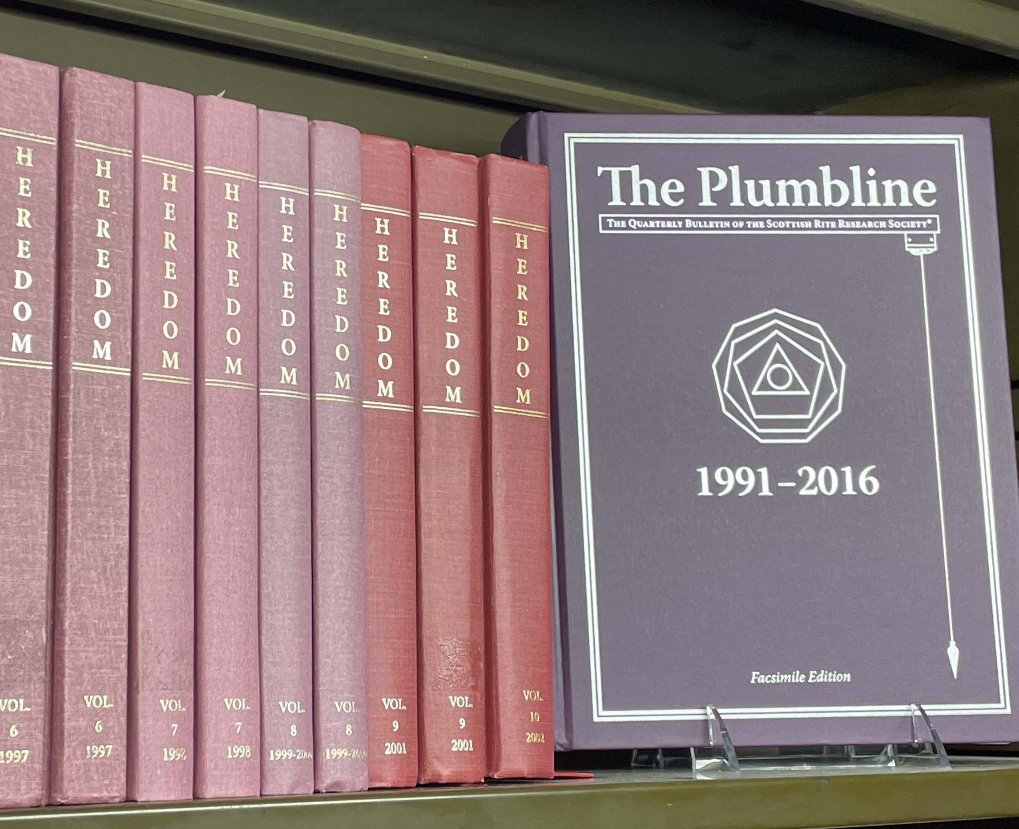
Scottish Rite Research Society - Publications
Research Society of the Southern Jurisdiction
  Open to all (Masons & non-Masons)
The Plumbline (Quarterly newsletter)
Heredom (Annually journal of papers)
Limited Edition Series
  (Formerly Known as “Bonus Books”)

Slide 21
Publications Timeline
March:
Plumbline Spring
June:
Plumbline Summer
Fall:
Heredom
January 2026
Feb: Boyden’s Chronology of SC
May:
Lodges of Sorrow
May:
11 Gentlemen of Charleston
August:
SRRS Online

Slide 22
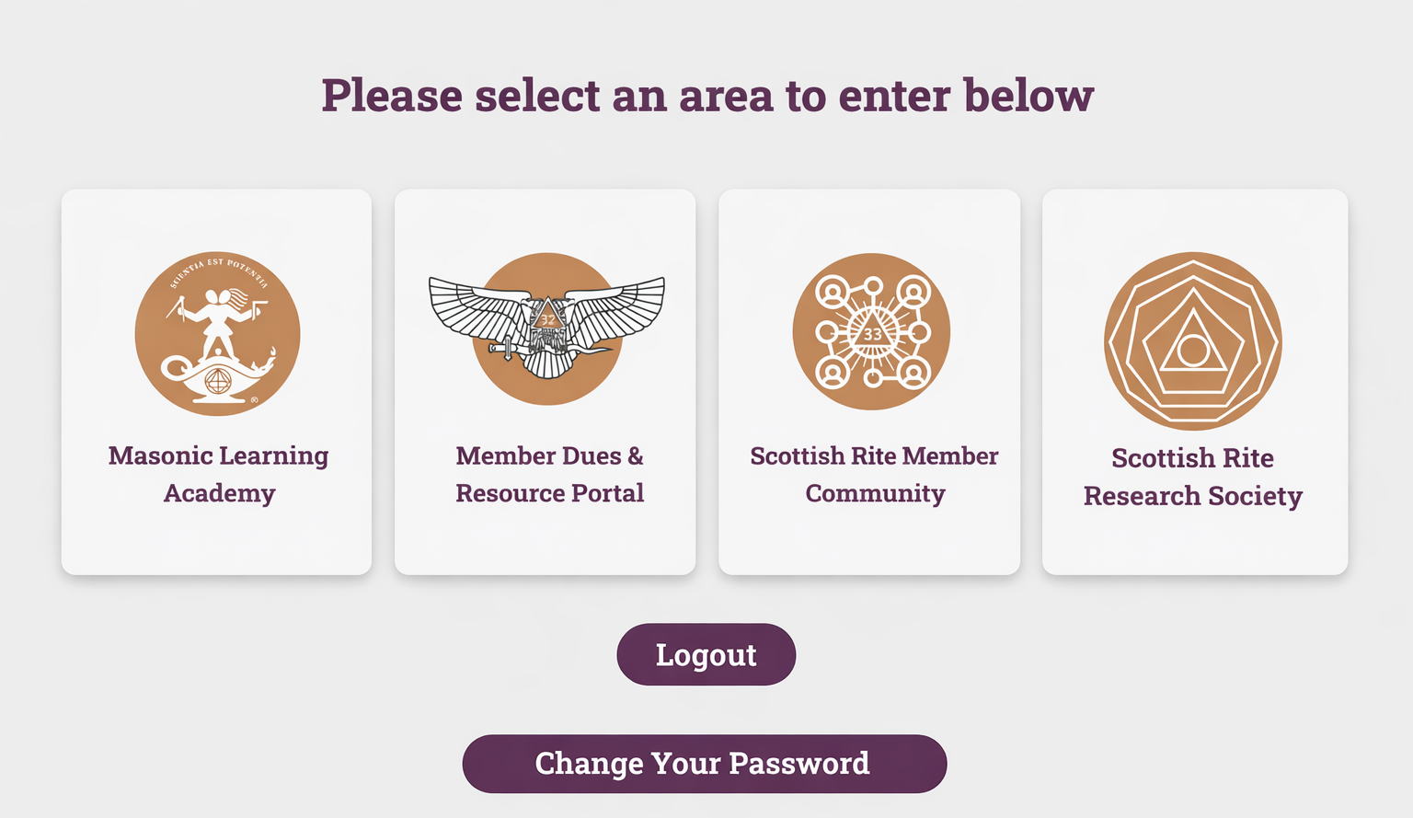
What is SRRS Online?
Entire catalog of
  The Plumbline
  Heredom
  Select Past books
Access anywhere, anytime
OCR searchable
Pay dues, update address
Non-SJ Member Access
2027+
  Image Center
  Public Access Papers

Slide 23
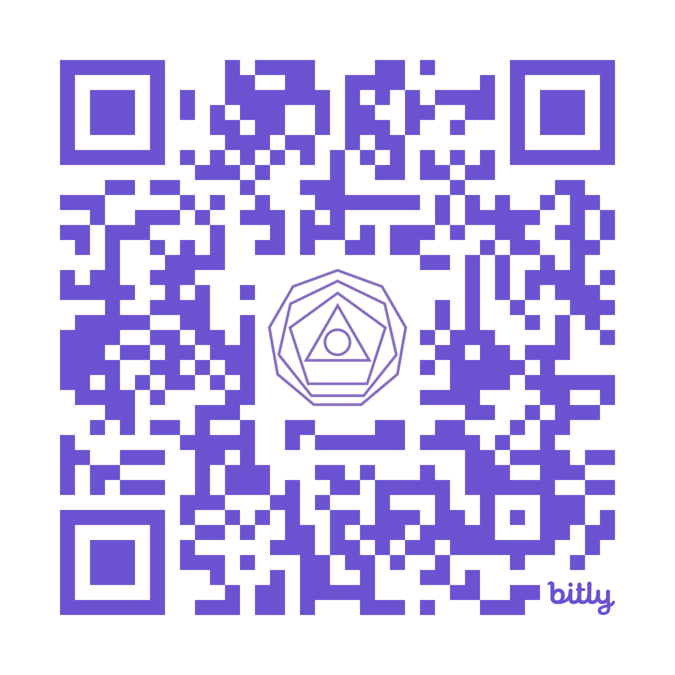
Thank you!
B. Chris Ruli, 32°, KCCH
SRRS@ScottishRite.org
Scan to Join SRRS

Slide 24
Welcome to

Slide 25


THE
Scottish Rite of Freemasonry
SUPREME COUNCIL, 33° SOUTHERN JURISDICTION, USA
Here to Help
Advancing the Scottish Rite Mission Through Charitable Works
Steve Banowit, 32° KCCH
Development Officer
Mid-Atlantic Region
Development Department
Rite Works 2026
Las Vegas – Dallas - Charlotte

Slide 26
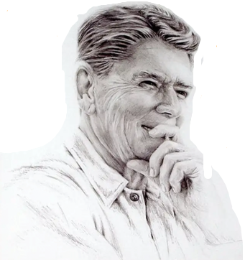

“The nine most terrifying words in the English language are; I’m from the government and I’m here to help.”
- Ronald Reagan
Aug. 12, 1986 News Conference
Notes:
Skepticism of government inefficiency and intervention.

Slide 27
A Collaborative Model
Mission Impact
Resources
Information
The Development Department connects information and resources to empower the
Scottish Rite mission
Tasked to work for Valleys/Orients – not just Supreme Council
> 50% of funds raised go to local/Orient efforts
Notes:
A collaborative model.
Tasked to work for the Valleys/Orient not just SC.
More than 50% of the funds raised got to local/orient efforts.

Slide 28
Philanthropy is a Core Tenant
Misson Statement
It is the mission of the Scottish Rite of Freemasonry, SJ, to improve its members and enhance the communities in which they live by teaching and emulating the principles of Brotherly Love, Tolerance, Charity, and Truth, while actively embracing high social, moral, and spiritual values, including fellowship, compassion, and dedication to God, family, and country.
Rite of Destitution (contribute as liberally as you can)
Closing Charge (befriend & relieve)
Notes:
Why do we give?
Masons by nature are charitable. We are charge to help those less fortunate
The 8th Degree “Intendant of the Building” teaches us to be benevolent and charitable.
Pike believed “A Masonic Lodge should resemble a bee-hive, in which all the members worth together with ardor for the common good.”
Remember what we do for ourselves dies with us….what we do for others is eternal.

Slide 29

To Leave a Legacy
An Example
Speech and language programs
Decentralized – Orients choose how best to engage with their communities
Colorado: early 1950s – Scottish Rite Masons decide to help
Colorado alone has helped >25,000 children through Rite Care
Notes:
We also give to leave a legacy.
Many of you have undoubtedly heard about our Rite Care program.
Unlike Shriners Health Care, the Scottish Rite does not operate Rite Care as a centralized system.
Each Orient decides the best way to run their program.
The idea of Ritte Care began in Colorado in the early 1950s to support a young boy of 4 who had no ability to speak. His mom was raising another child on a Secretary's salary. Scottish rite Masons working together laid the ground work for what we now know as Rite Care. Colorado has assisted over 25,000 children alone. Think about how many children have been helped in your Orient. Would it be far fetched to say RiteCare has helped over a million children?
It just goes to show that good ideas from humble beginnings can leave a lasting legacy!

Slide 30
Creating a Culture of Giving
Awareness and engagement
Multiple ways to participate
Shared goals
Clear communication
Notes:
Some ideas on how to create a culture of giving…
Awareness and engagement
What percentage of your members actually understand how your Philanthropic programs are put in place.
Be sure to get the word out, not just at your meetings, but in your newsletters, social media efforts, and to your communities
There is no one reason driving folks to support charities. They don’t have to be just our members
Share stories of member’s impact in the community. If you share a story the concept is more relatable.
Provide multiple ways for people to participate
Use different engagement styles, no single approach fits all Valleys or Orients.
Example: One Valley does a great job throwing a BBQ, but another Valley might do a better job of holding a golf tournament.
Shared Goals
What are the goals of your foundations, provide updates and comparisons. How much have you grown what has been achieved? Where do you want to go next with your goals?
Clear Communication
Clearly communicate your shared goals, and know that members who attend in person may not be the donors you need to speak with.
How can you reach those members who are not attending?
Consider pairing direct mail with email for awareness campaigns.
Having clean and accurate data for membership and prospective donors is very important.
Nothing replaces a phone calls and personal contact, even in 2026.
Your Donor Officers can help with the development of a plan for your valley

Slide 31

Quantify Needs & Success
What we need
With cash gifts and planned gifts totaling X amount
What we accomplish
We can help Y number of children
Notes:
Let folks know your RiteCare annual budget, the numbers of children helped.
If possible, tell a family success story at your Valley meeting. Bring in Clinicians to provide success stories.
Don’t forget to brag to non—members, they too can give to our efforts!
Remember that giving has become a competitive space. Many organizations are vying for your members time and treasure. Make a compelling case to stay top of mind.

Slide 32
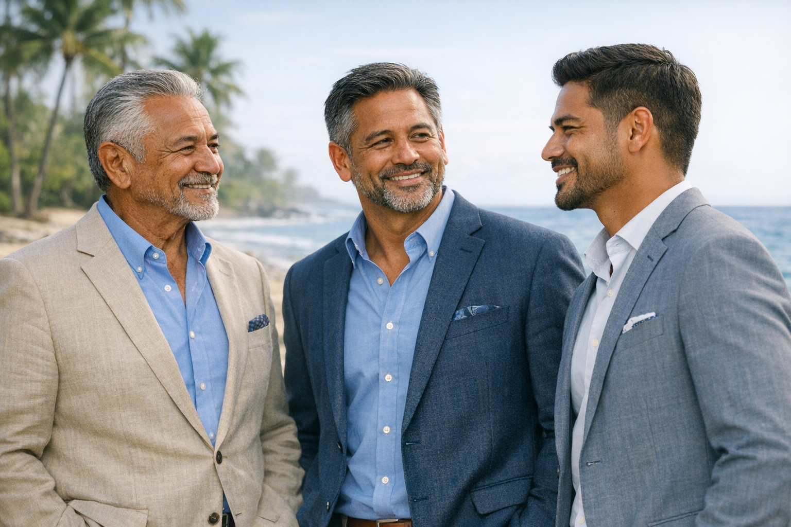
Engage Every Generation
Everyone has a role to play.
Different ages, different experiences, different means
but… shared purpose!
Notes:
Greatest Generation, Boomers, Gen-X, Millenials, Gen-Z…
We are all SR Masons and we all want to help. Everyone can participate in some way.
Whether it be small gifts, acts of service, leadership role, or legacy gifts.
Emphasize participation over amounts.
When it come s to contributions, Different folks give differently, younger members might prefer giving more frequently in smaller amounts, they know technology….Can they give thru your web site?
Older generations are looking to do something good with their wealth and assets, while also enjoying some tax benefits. Those who give small amounts on a monthly basis today, may be your major donors later in life.

Slide 33
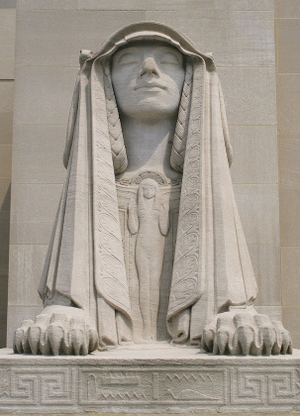
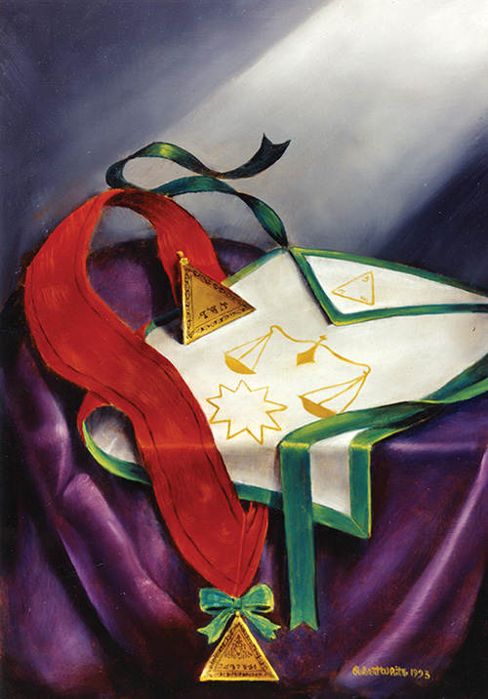

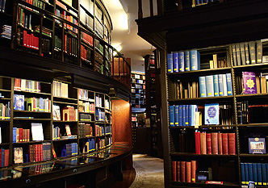

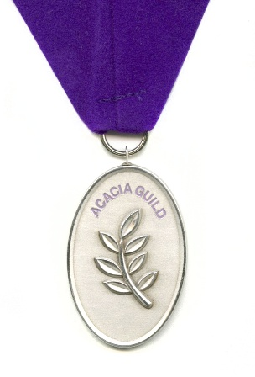
Programs at all Levels
100% Tax Deductible
Sphinx of Wisdom
$100 and up
Appendant Bodies Achievement Grants & Masonic Youth Performance Grants
Intendant Of The Building Society
Any Amount – include SR in your estate plan.
SC Foundations
Your Orient/Valley
You decide!
Adopt-a-Book
$250 and up
Rebuilding the Temple Campaign
Scholarships
One Year / One Time
$1,000 and up
Endowed
Named scholarship
$50,000 minimum
Acacia Guild
$1,000/yr ($88.33/mo.)
50% HOT Historic Preservation Fund
50% Scottish Rite Foundation
Rebuilding The Temple Campaign
Any Amount
HOT Historic Preservation Foundation
Notes:
Examples of SC programs across the spectrum of giving levels.
Do you have similar entry points in your Orient/Valley?
Don’t forget to offer non-donation paths to giving!
Volunteer time.
Give blood, etc.
All of this feeds and reinforces our culture of giving.

Slide 34
Trends in Generational Giving
The Great Wealth Transfer
                $84 - $124 trillion bequeathed through 2045
                Handover from Boomers and Silent Generation to younger generations
Not all left to heirs – “giving while living” is happening (est. $12-$18 trillion)
How can we be good stewards?
                Educate your membership!
                What are your foundations and how do they work?
                Tax ID numbers and key contacts
Tomorrow’s heirs may become tomorrow’s donors!
Notes:
While much will be inherited by Gen X and Millennials, a significant portion will be transferred through "giving while living" (donating or gifting before death).
$12-18 Tillion is expected to be donated to charities, how can we be good stewards?
Educate your membership. What are your foundations and how do they work? Have your official foundation names and tax ID numbers available for use with a brief description of what each foundation does and a key contact.

Slide 35

Use Scottish Rite Tools!
40% HOT & SR Foundation
60% Orients & Valleys
Began offering in 2022
> $25 Million designated to
Scottish Rite charities so far!
  www.FreeWill.com/ScottishRite
Notes:
Began use in April 2022
A web-based service provided for free to all members.
Easy to use online software just like “TurboTax”
Featured in New York Times, Forbes and Reuters
More than $25,000,000 designated in wills & trusts to Scottish Rite causes
60% to Valleys and Orients
40% to House of the Temple & SR Foundation
Don’t forget This is a membership perk.

Slide 36
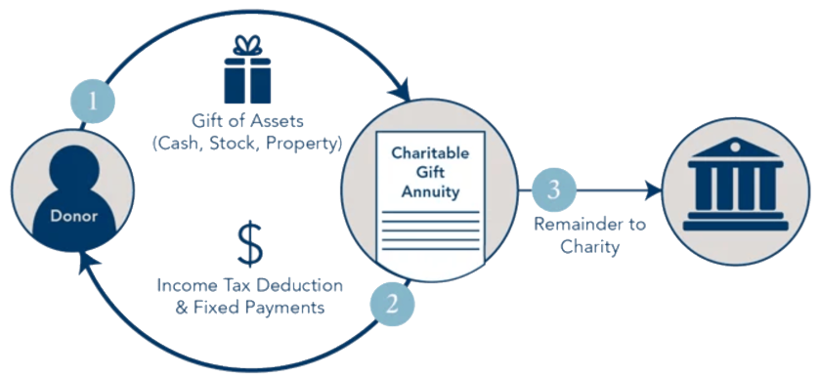

Financial Planning Tools Also Available
Charitable Gift Annuity
Notes:
CGA’s are another great tool for helping to manifest your Masonic Mission.
A CGA is a contract between a charity such as the Scottish Rite Foundation, and a donor. In exchange for a cash gift, the annuitant receives a guaranteed regular income until death in addition to a tax deduction.
Rates are based on the American Council of Gift Annuities and vary based on the age of the annuitant.
One thing to keep in mind - if a donor is at least 70 ½ years of age, they can make direct transfer from their Independent Retirement Account (IRA) to a qualified charity, the money donated never enters their bank account and so is not included in taxable income.
Of our Approx 108,000 members in the Southern Jurisdiction 55% is aged 70 or older, this presents a huge opportunity for these members to make an impact for our Foundations!

Slide 37
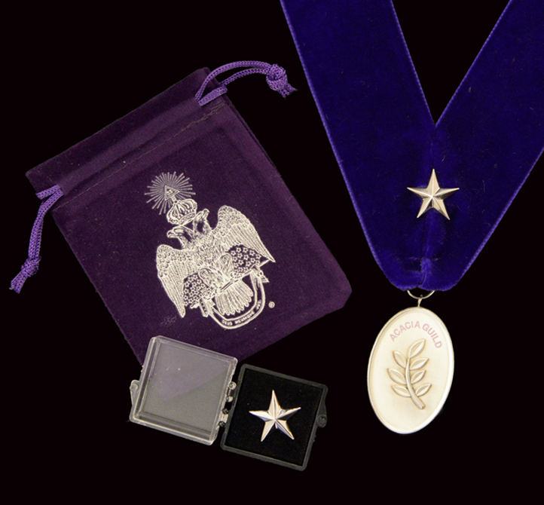
Programs Can Be Tools Too
Acacia Guild
  Donor-based society with a 2-Way Split
  House of the Temple Historic Preservation Foundation Inc.
  Scottish Rite Foundation, Southern Jurisdiction, U.S.A. Inc.
  Exclusive access to Acacia Guild & IOBS Reception at
  Biennial Session
  $1,000 a year or $83.33 per month
  Renew each year to receive an additional silver star
Notes:
Are there any Acacia Guild members here today?
Please stand and be recognized (round of applause).
Acacia Guild funds are split evenly between House of the Temple Historic Preservation Fund and The Scottish Rite Foundation
Let’s remind ourselves…
HOT
This is to support the headquarters of the mother council of the world! Modeled after one of the 7 wonders of the world, the Tomb of Mausolus at Halicarnassus, in Turkey. Designed by John Russell Pope, who was the architect behind the Thomas Jefferson Memorial, National Archives Museum, National Gallery of Art’s West Building. Final resting place of our First Sovereign Grand Commander Albert Pike.
SRF
This is supporting…
RiteCare Scottish Rite Childhood Language Program (SRCLP)
Scholarships
Grants
Community support and disaster relief
The medallion:
.999% fine silver with a soft purple collar and Velcro clasp
Each are individually numbered
Features the symbol of immortal life, the acacia plant
For each year of membership in the Guild the recipient earns an additional sterling silver star to add to the ribbon
Recent tax changes means that you can deduct your Acacia Guild membership without needing to itemize on your taxes

Slide 38
Recognition Programs are Tools – E.g.,
Intendant of the Building Society
Awarded to anyone who has included the Scottish Rite Foundation, HOT Foundation, or their local SR Foundation in their wills, trusts, IRAs, pensions, life insurance, annuities, etc.
Certificate of Membership & welcome letter
Society pin
Choice of society tie or scarf
The 8th Degree - Intendant of the Building
Teaches the lessons of benevolence and charity; the importance of transmitting ethics and moral lessons to the next generation; and that labor is honorable if done with sobriety, temperance, punctuality, and industry.

Slide 39
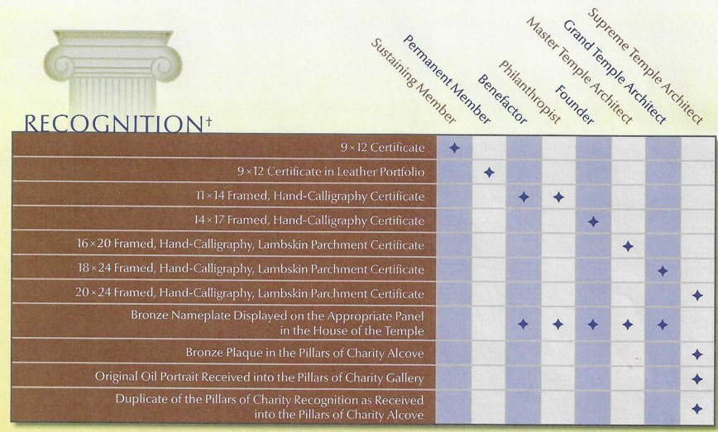
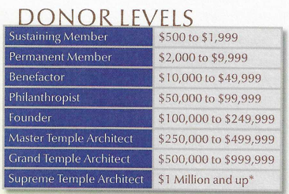
Donor Recognition - Overview
Notes:
The Scottish Rite Donor Recognition Program honors our brethren, family, and friends who have made generous financial contributions to the Scottish Rite philanthropies, such as the House of the Temple Historic Preservation Foundation, The Scottish Rite Foundation or local Scottish Rite programs.
Donations are cumulative over a member’s lifetime, so even the smallest gift can snowball into something but larger as time goes on, you never know…

Slide 40
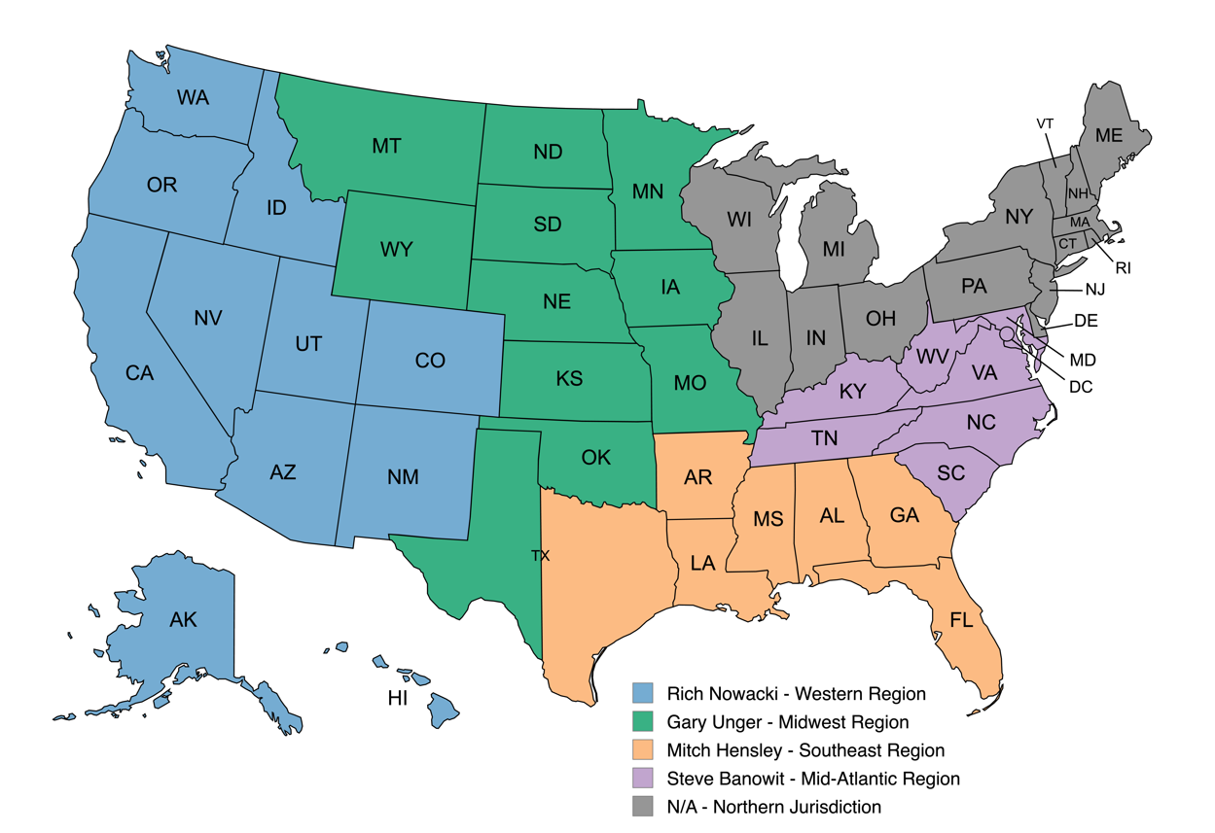
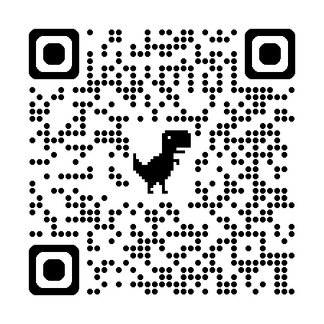
What Next?
Get in touch with your Donor Officer!
Notes:
Let’s brainstorm, review what’s working and what’s not working as far as development is concerned in your Valley.
The Development Office operates at no cost to you, why not take advantage of our tools and expertise?
We cover a vast array of Valleys and Orients, we can provide insights to you that can save you time and headaches
Please take information back to your Valleys and help keep what we have discussed today “top of mind” for your membership, create that culture of giving we discussed earlier

Slide 41
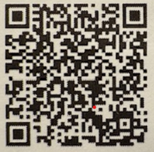
Questions?
Please contact me:
Steve Banowit, 32° KCCH
sbanowit@scottishrite.org
(202) 777-3183
Or Use our QR code to donate:
“What we have done for ourselves alone dies with us;
what we have done for others and the world remains and is immortal.”
- Albert Pike

Slide 42
Welcome to
Notes:
Introduce Peyton Anderson, 32°

Slide 43
The Consistory’s New Counselor:
Artificial Intelligence as a Strategic Partner.

Slide 44
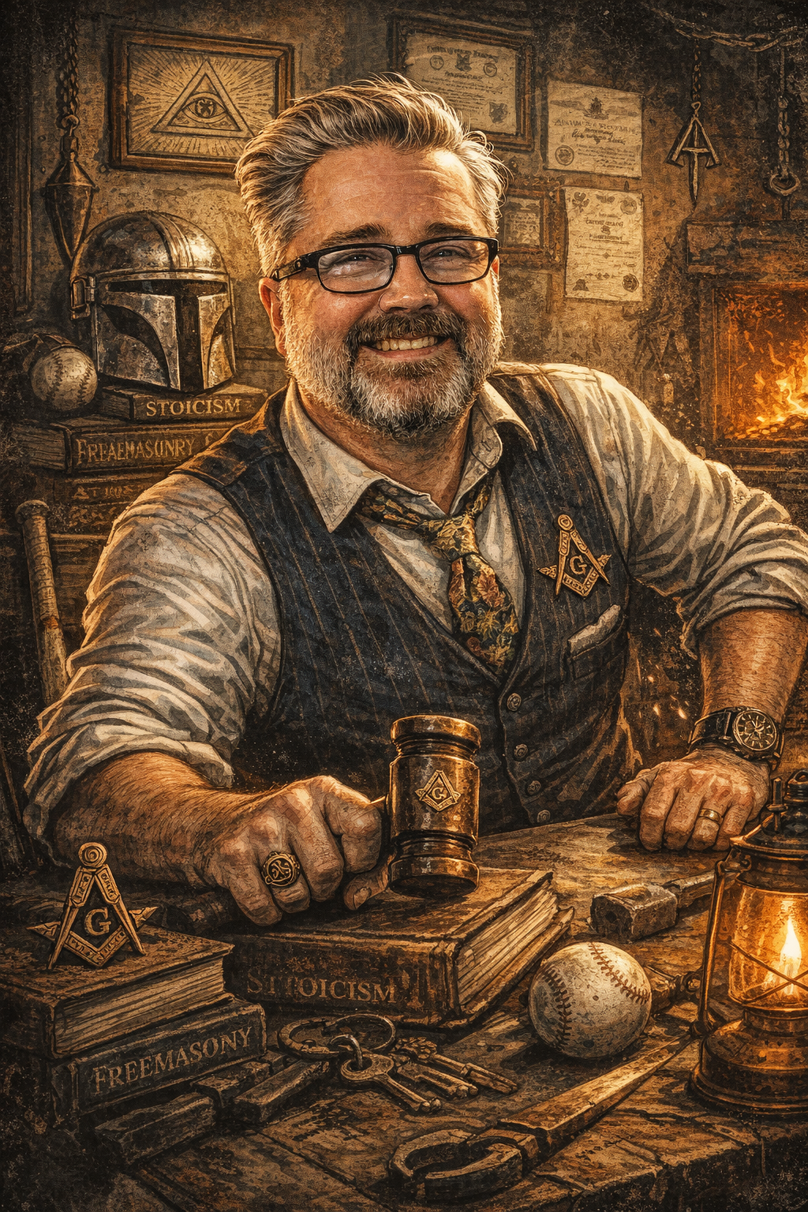
Peyton Anderson
Orient of Virginia
Valley of Richmond
Grand Commander’s Fellow
Father. Husband. Blacksmith. Outdoorsman. Stoic.

Slide 45
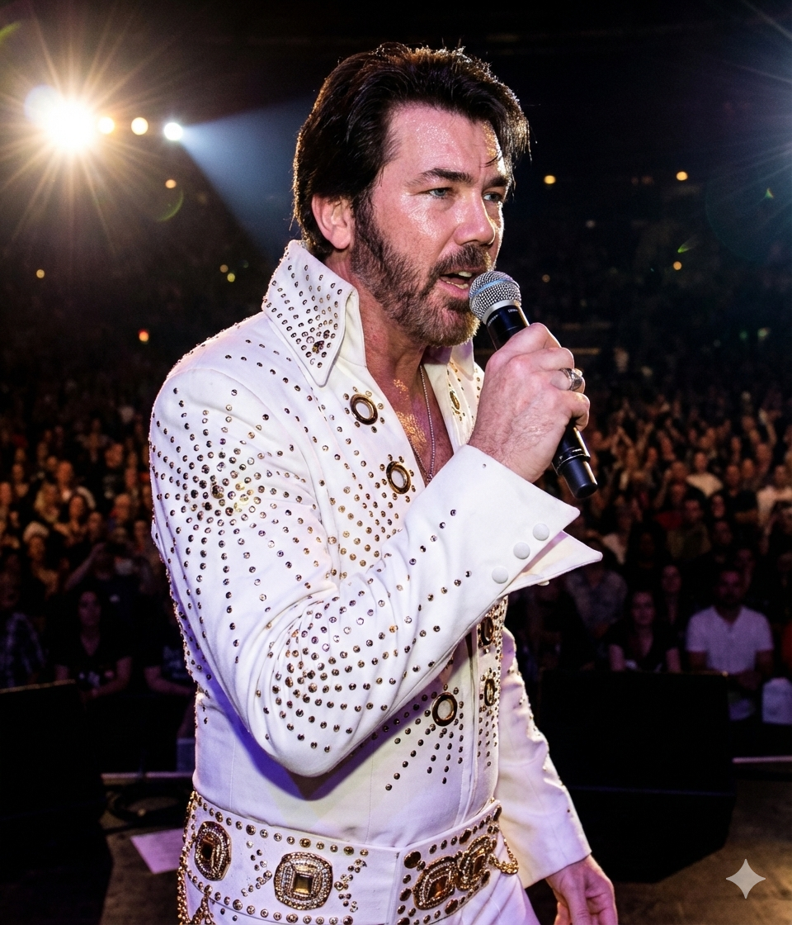

Slide 46
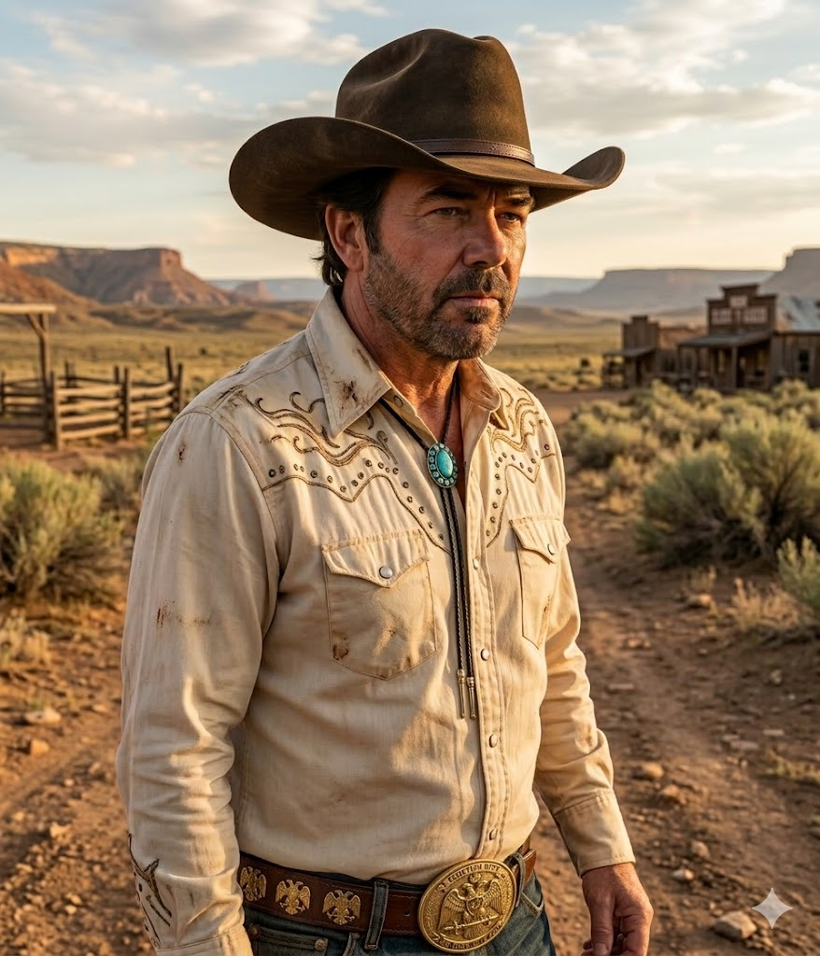

Slide 47
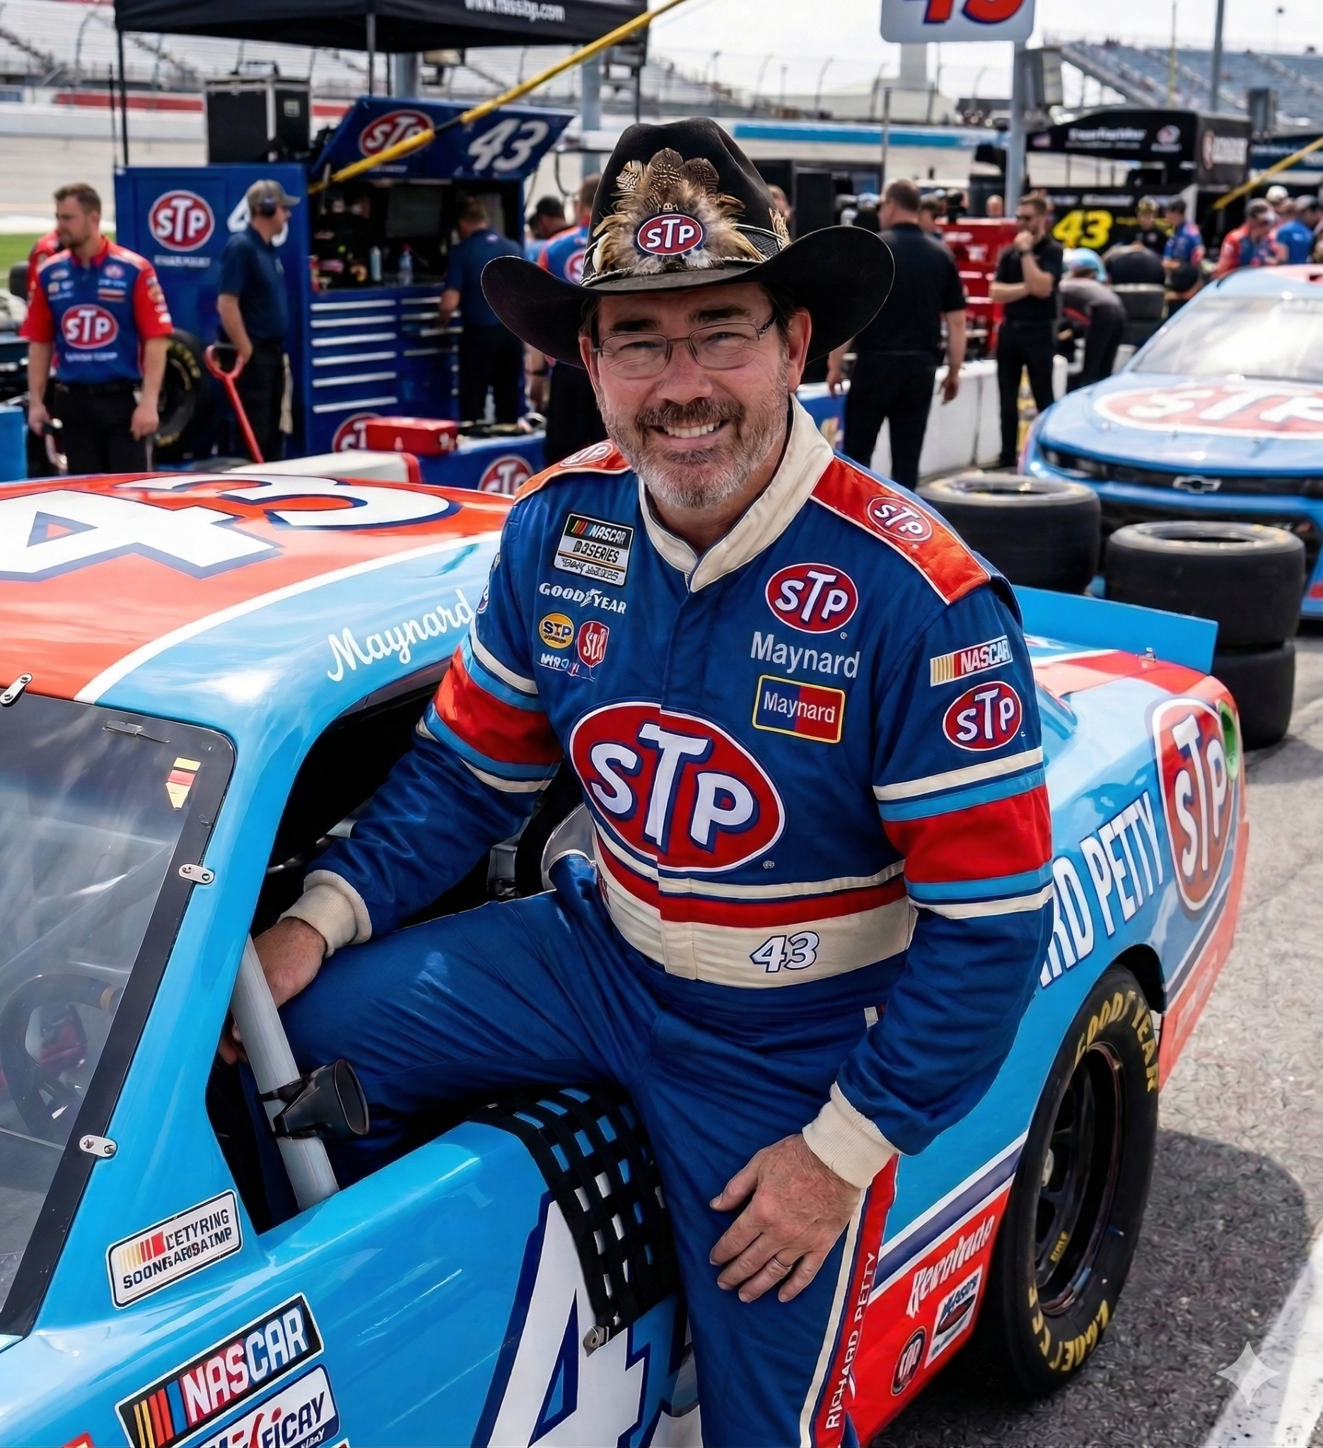

Slide 48
https://bit.ly/AASR2026

Slide 49
The Challenge:
“You always own the option of having no opinion.” -Marcus Aurelius
Listen with the intent to be influenced.
LET’S HAVE SOME FUN TODAY!

Slide 50
Targeted Outcomes
1 | Better understand how Generative Artificial Intelligence works & suggested tools.
2 | Learn strategies to use AI in the planning and implementation of tasks
3 | Explore real examples on how Generative Artificial Intelligence has been used in a Lodge (image/event flier generation, membership data analysis, educational talks, etc.
4 | Identify one way to incorporate Generative Artificial Intelligence immediately.

Slide 51
01
How Gen AI works & suggested tools

Slide 52
Learning: It studies billions of examples to understand "rules" (like how a sentence is structured or what a sunset looks like).
Creating: When you give it a prompt, it uses those rules to predict what should come next, resulting in a unique output.

Slide 53
Generative AI is…
The World’s Fastest Intern
A Guessing Machine
An Artistic Parrot
A Brainstorming Partner
A Language Translator

Slide 54
Generative AI is NOT…
A Truth-Telling Encyclopedia
Skynet or "Alive"
A Decision Maker
A Mind Reader
A Researcher

Slide 55








“Freemium” Tools

Slide 56
Classification of AI
ChatGPT | Gemini | Grok | Notebook LM
Text rich Can do images Can attach | Text rich Can do images Can attach Can share Gems | Specializes in images and short videos | Closed system Does not use internet Lots of control
Uses your history Very limited inquiries (10 every 5 hours) | Uses your history Large amount of inquiries (200 per day) | Does not do well with text and image generation | Document load limit

Slide 57


Slide 58
02
Strategies
to use with AI

Slide 59
V.A.L.L.E.Y. for your Valley (prompt engineering)
V | VESTIGE (The Context) | Don’t just ask for a letter. Tell the AI who is writing it and why. "I am the VMAP Chair of a Scottish Rite Valley with approximately 1,000 members."
A | ACTOR (The Role) | Tell the AI to "Act as..." a specific expert. "Act as a Professional Recruiter and expert in non-profit member engagement."
L | LIMITS (The Boundaries) | Tell the AI what not to do or how long the response should be. "Keep the response under 300 words and do not use overly technical jargon."
L | LOGIC (The Task) | Define the specific task clearly. Use verbs. "Analyze these meeting minutes and extract the three most urgent action items."
E | ESSENCE (The Tone) | Describe the "vibe" or style you want. "The tone should be formal, encouraging, and reflect the values of the Scottish Rite."
Y | YIELD (The Output Format) | Tell the AI exactly how you want the information delivered. "Present this as a bulleted list ready to be pasted into a PowerPoint slide."

Slide 60
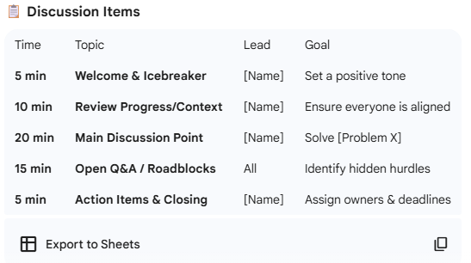
V.A.L.L.E.Y. in action…
“Zero Shot”...
I need an agenda for my meeting.

Slide 61
V.A.L.L.E.Y. in action
V | VESTIGE (The Context) | "I am the Venerable Master of the Richmond Valley Scottish Rite."
A | ACTOR (The Role) | "Act as a my assistant and expert in time management."
L | LIMITS (The Boundaries) | "Keep the response short and concise so I do not get lost when reading it."
L | LOGIC (The Task) | "Create an agenda for me for a 60 minute meeting that allows for me to welcome everyone, the treasurer and secretary reports to be read, charity basket passed around, 10 minute educational program presented, 5 minutes for the Personal Representative to give his remarks and no more than 15 minutes for general discussion."
E | ESSENCE (The Tone) | "This is professional and to the point."
Y | YIELD (The Output Format) | "Present this as a table with specific times connected to each section."

Slide 62
V.A.L.L.E.Y. in action…
I am the Venerable Master of the Richmond Valley Scottish Rite. Act as a my assistant and expert in time management. Keep the response short and concise so I do not get lost when reading it. Create an agenda for me for a 60 minute meeting that allows for me to welcome everyone, the treasurer and secretary reports to be read, charity basket passed around, 10 minute educational program presented, 5 minutes for the Personal Representative to give his remarks and no more than 15 minutes for general discussion. This is professional and to the point. Present this as a table with specific times connected to each section.

Slide 63
V.A.L.L.E.Y. in action…
Time | Duration | Agenda Item | Responsible Party
00:00 – 00:05 | 5 Min | Welcome & Opening Remarks | Venerable Master
00:05 – 00:10 | 5 Min | Secretary’s Report | Secretary
00:10 – 00:15 | 5 Min | Treasurer’s Report | Treasurer
00:15 – 00:20 | 5 Min | Charity Basket Collection | Captain of the Host
00:20 – 00:30 | 10 Min | Educational Program | Designated Speaker
00:30 – 00:35 | 5 Min | Personal Representative Remarks | Personal Representative
00:35 – 00:50 | 15 Min | General Discussion / New Business | Assembly
00:50 – 01:00 | 10 Min | Closing Ritual & Adjournment | Venerable Master

Slide 64
02
Gen AI in your Valley

Slide 65
Education
Budget
Agendas
Help write a talk on a specific topic.
Load in documents / details to create.
List what you need covered and how long you have.
Assistant
Fliers & Images
Messaging
Load documents and create a reference guide.
Special events and fundraiser visuals.
Trestleboard creation, targeted mailings, etc.
Click here for cool stuff

Slide 66
Education
Assistant
Fliers & Images
I am the Orator for the richmond Valley Scottish Rite and I have been asked to create an educational program centered on the Feast of Tishri. In no more than 15 minutes, I want to connect the traditions and ritual of this to everyday mindfulness and thankfulness. Create this as an outline for a slide deck.
Help me analyze the data from member satisfaction surveys to better understand areas of growth, improvement, and celebration for our Valley. Provide pie charts and other visuals to best understand the story the data tells us.
Create an image to best commemorate my session entitled, “The Consistory’s New Counselor: Artificial Intelligence as a Strategic Partner” held in Las Vegas. Center the design on the famous Las Vegas sign. Do not make this look like an image. I want more of a gritty comic book feel to it. This link must also be in there: https://bit.ly/AASR2026

Slide 67
03
Incorporate Gen AI immediately

Slide 68
Remember!
NO sensitive / personal info!
Answers are like fingerprints
You can’t break it

Slide 69
V.A.L.L.E.Y. for your Valley (prompt engineering)
V | VESTIGE (The Context) | Tell the AI who is writing it and why.
A | ACTOR (The Role) | Tell the AI to "Act as..."
L | LIMITS (The Boundaries) | Tell the AI what not to do or how long the response should be.
L | LOGIC (The Task) | Define the specific task clearly. Use verbs.
E | ESSENCE (The Tone) | Describe the "vibe" or style you want.
Y | YIELD (The Output Format) | Tell the AI exactly how you want the information delivered.

Slide 70
Find the low hanging fruit! (VMAP)
Find the youngest member of your Valley and empower them to help!
Use Gen AI to do something everyone hates or is unwilling to do (budget, a talk, etc.)!
Install something on your phone and PLAY!

Slide 71
SRLC 2026 Resource Folder
Today’s slide deck
VMAP Template (example)
Membership Satisfaction Survey Template
Gemini
Notebook LM
Mind-Blowing Ways Freemasons Are Using AI RIGHT NOW!
“17.7 Initiative” - Formal Nomination Process for new members

Slide 72
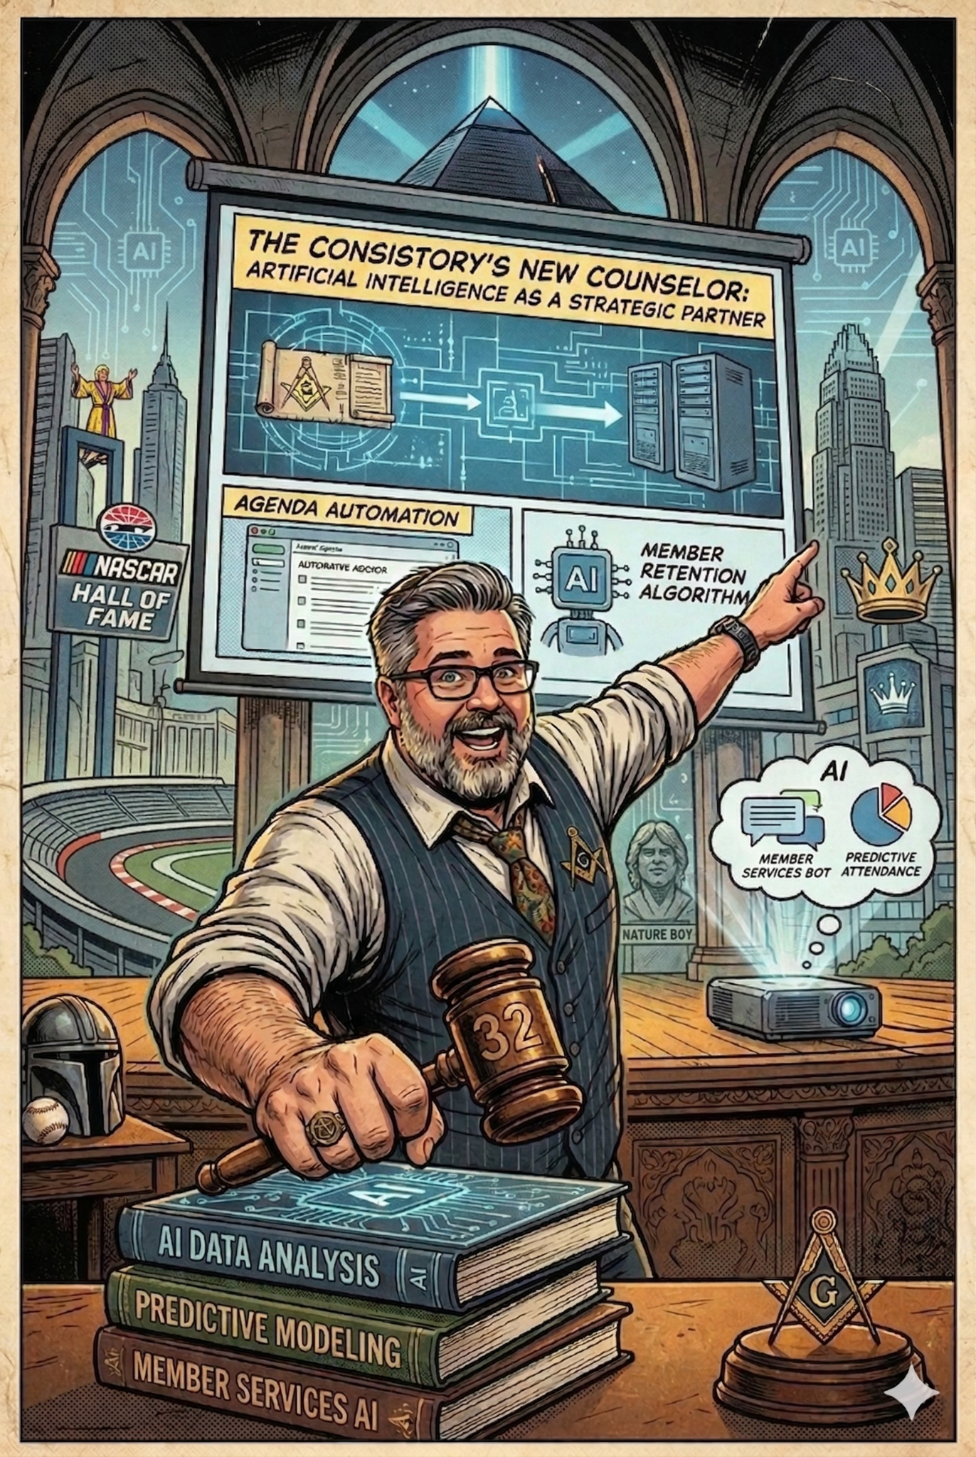
Thanks!
Any questions?
peyton6720@gmail.com

Slide 73
Welcome to
Notes:
Introduce Peyton Anderson, 32°

